Slide 1



Project Proposal
Sales Dashboard (New Markets & Opportunities)
Group 3
Parina, Aditya, Vidita, Shikha

Slide 2



DASHBOARD TO EXPLORE NEW MARKETS AND SALES OPPORTUNITIES
PROJECT TOPIC
OBJECTIVE
Drive Revenue Growth: Identify and capitalize on new sales and market opportunities through data-driven insights on historical sales, product categories, regional performance, and sales rep effectiveness.
Optimize Sales & Marketing Strategies: Tailor pricing strategies, product development, and sales efforts to capture underserved markets and product categories, maximizing sales potential.
Enhance Decision-Making: Leverage data analysis to make informed decisions on product pricing, sales rep training, and market expansion, ultimately achieving sustainable revenue growth.

Slide 3
DASHBOARD USERS
1
Sales and Marketing Department
2
Product Development team
3
New Product Innovation

Slide 4
DASHBOARD INSIGHTS
Sales Analysis: Visualize historical sales data (yearly, monthly, quarterly, weekly) for revenue and units to understand trends and identify potential growth areas.
Product Category Insights: Leverage data to uncover sales volume, revenue contribution, and growth rate per category and subcategory, further segmented by product pricing type. This allows you to plan for new product development by identifying high-performing or under-served categories within specific pricing models.
Geographic Market Exploration: Analyze regional sales, market share, high-performing and low-performing regions by unit and revenue. This aids in identifying new market opportunities for existing products.
Sales Rep Performance: Track sales by sales rep to identify strengths and weaknesses. This allows for targeted training and improvement of sales efforts towards new opportunities

Slide 5
APPROACH -
We plan to have the following key pages as mentioned below for our Power BI report. Team members responsible for each are as indicated
Overview (Key Performance Indicators): Parina & Team
Sales Analysis: Aditya
Product Category Insights: Vidita
Geographic Market Exploration: Shikha
Sales Rep Performance: Parina

Slide 6
TECHNICAL DETAILS
Project Duration | 4-5 weeks
Resource allocation | 4 Analysts
Data Sources | CSV (Sales) , SQL Server (Product details), Excels (Dimensions)
Data Fields | Sales for 4 years : fSalesPrimaryKey, ProductID, SalesRepID, Location, Date, Units, PercentOfStandardCost, RevenueDiscount Product details - Product ID, color, Retails Price, Standard Cost, Sub category Sales Rep - ID and name Geography - Place Subcategory - ID and category
Tech Stack | Power BI: Data visualization and reporting Data Cleaning and Preparation Tools: Power Query Data Modeling: Power Query or DAX for data modeling and relationships Collaboration Tools: Microsoft Azure (Sandbox environment), Microsoft Teams or SharePoint for team collaboration

Slide 7
PROJECT PLAN – Phase wise
Phase 1
(Week 1)
Phase 2
Phase 3
Phase 4
Data Source Connection: Confirm data availability and connect to Power BI.
Data Availability: Analyze data structure, identify relevant fields (sales figures, geography, product, sales rep, date), and assess data quality.
Data Prepping: Address missing values, inconsistencies, and format data for optimal analysis.

Slide 8
Phase 1 - Details
DATA PREPPING

Slide 9
DATA PREPPING APPROACH
We have 4 sales csv, 1 product SQL database, 4 dimension excels
Load table
Transform with errors
Review columns
Add/edit columns

Slide 10
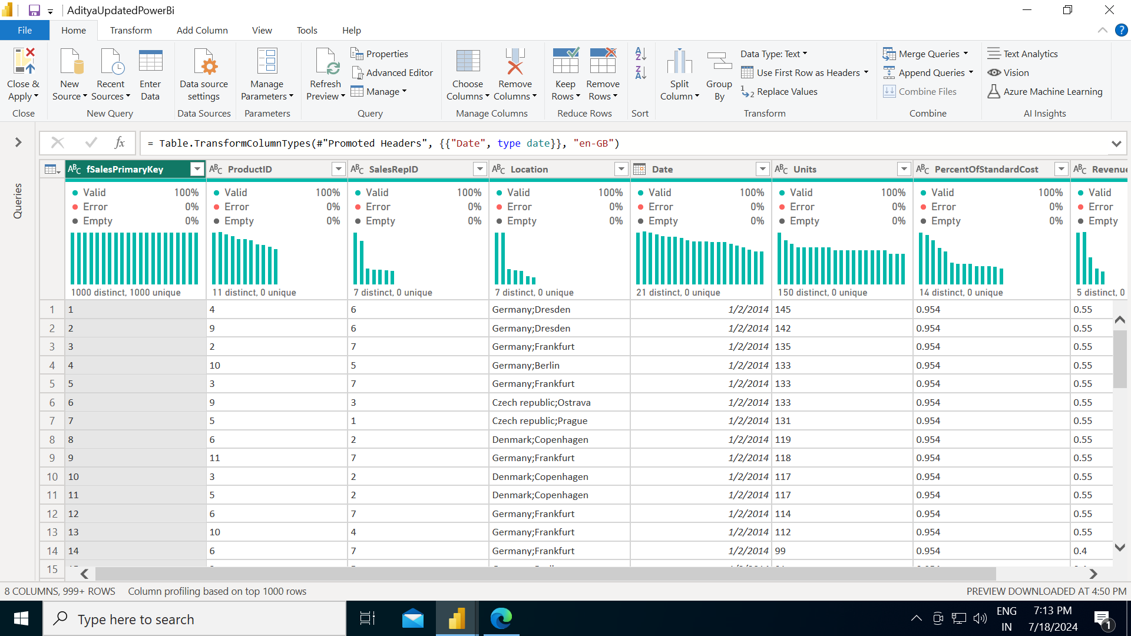
Sales Table
Date Field
Sales ID key rename
Geography ID added
Country, City field split
All errors checked
NULL values checked

Slide 11
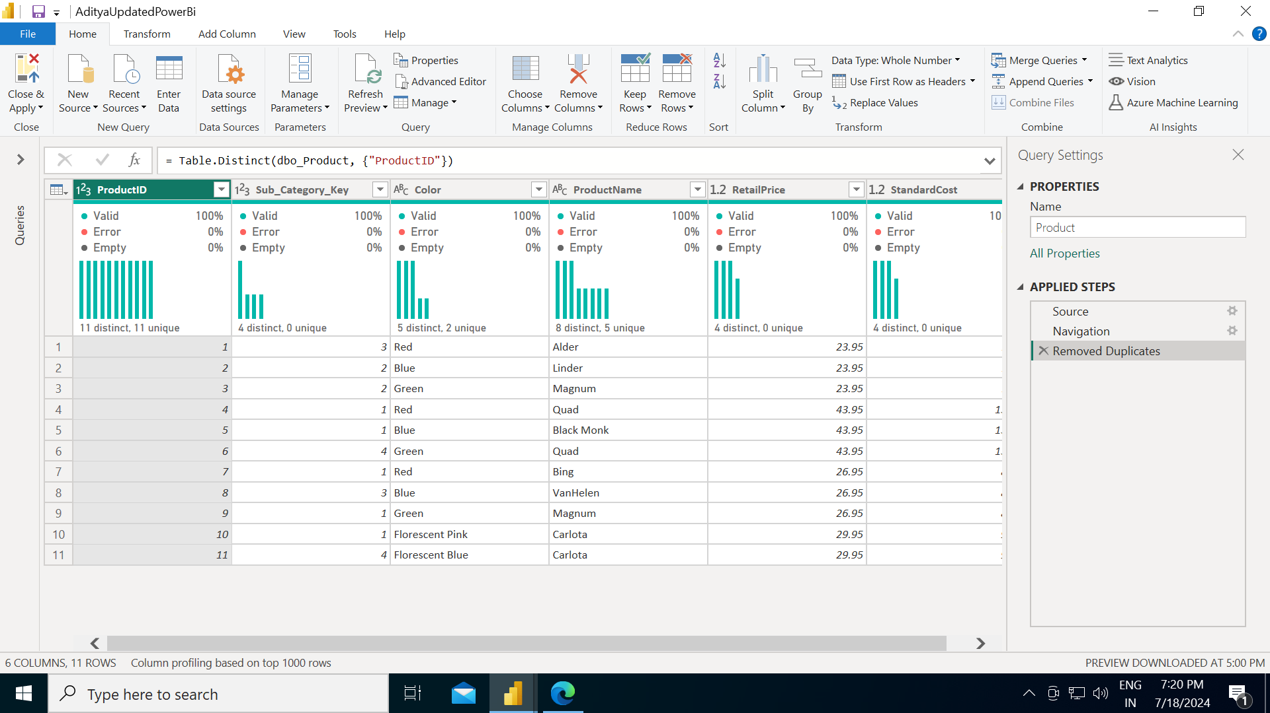
PRODUCT TABLE
Duplication removed
All errors checked
NULL values checked

Slide 12
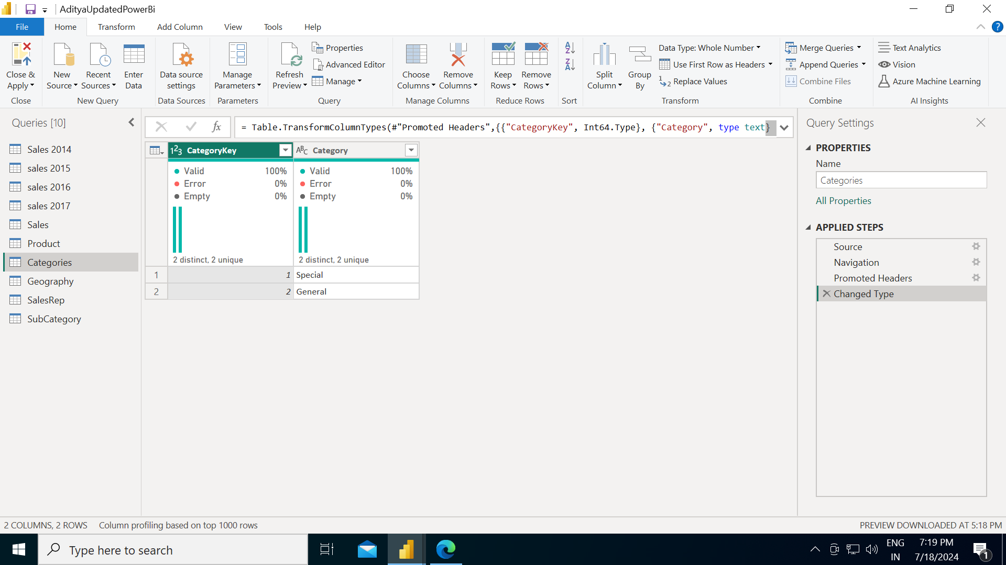
CATEGORY TABLE
Headers for columns fixed
All errors checked
NULL values checked

Slide 13
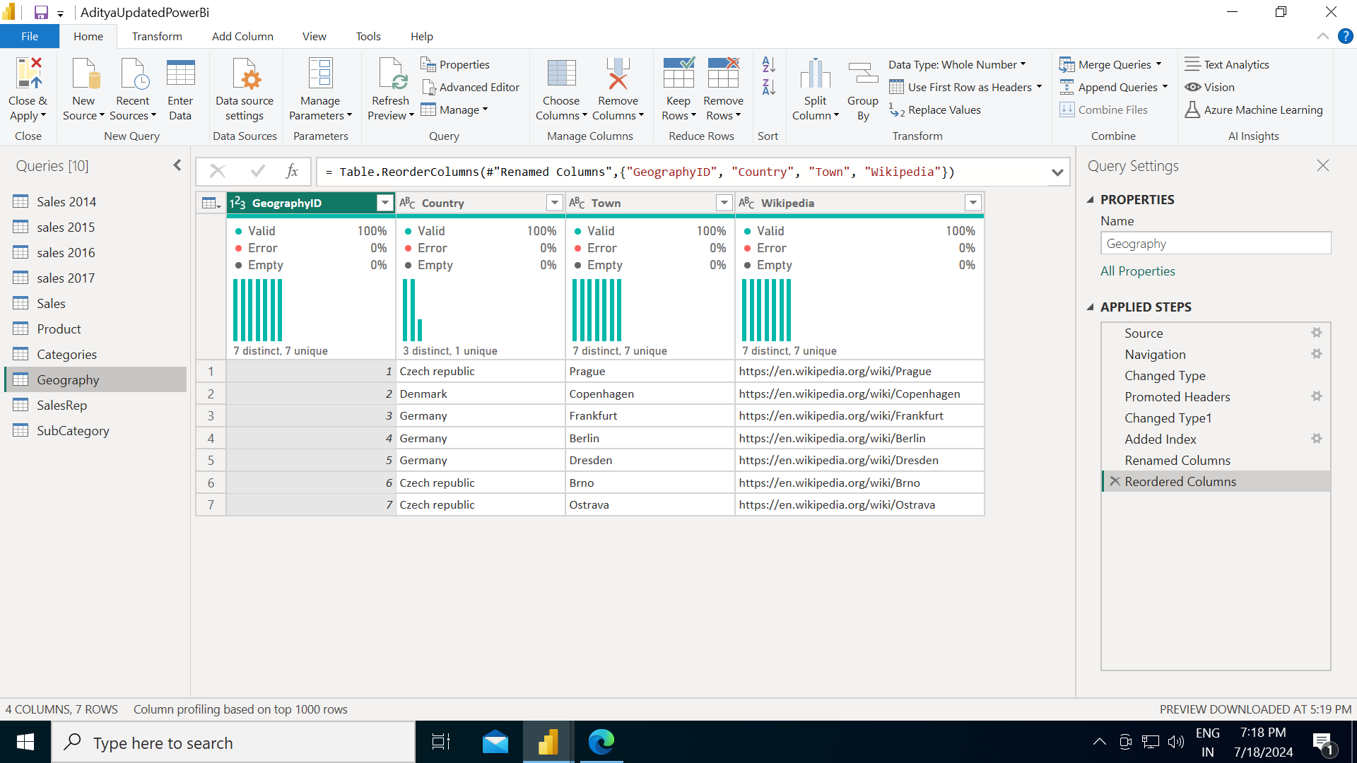
GEOGRAPHY TABLE
Added index
Geography ID added
Country, City field split
Changed type
All errors checked
NULL values checked

Slide 14
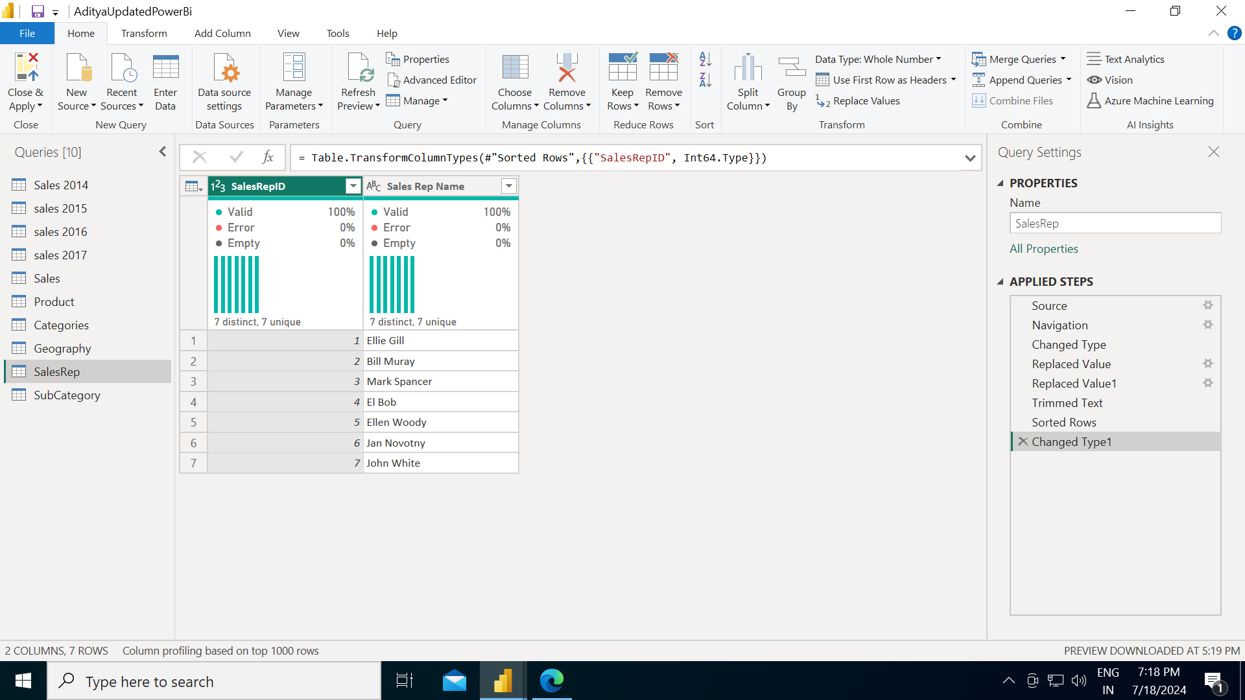
Sales Rep Table
Split column 1 to make it an ID
All errors checked
NULL values checked

Slide 15

Sub category Table
All errors checked
NULL values checked

Slide 16
Project -
Sales Dashboard (New Markets & Opportunities)
Group 3
Parina, Aditya, Vidita, Shikha

Slide 17
DASHBOARD TO EXPLORE NEW MARKETS AND SALES OPPORTUNITIES
PROJECT TOPIC
OBJECTIVE
Drive Revenue Growth: Identify and capitalize on new sales and market opportunities through data-driven insights on historical sales, product categories, regional performance, and sales rep effectiveness.
Optimize Sales & Marketing Strategies: Tailor pricing strategies, product development, and sales efforts to capture underserved markets and product categories, maximizing sales potential.
Enhance Decision-Making: Leverage data analysis to make informed decisions on product pricing, sales rep training, and market expansion, ultimately achieving sustainable revenue growth.

Slide 18
PROJECT PLAN – Phase wise
Phase 1
(Week 1)
Phase 2
Phase 3
Phase 4
Data Source Connection: Confirm data availability and connect to Power BI.
Data Availability: Analyze data structure, identify relevant fields (sales figures, geography, product, sales rep, date), and assess data quality.
Data Prepping: Address missing values, inconsistencies, and format data for optimal analysis.

Slide 19
PROJECT PLAN – Phase wise
Phase 1
(Week 1)
Phase 2
Phase 3
Phase 4
Data Source Connection: Confirm data availability and connect to Power BI.
Data Availability: Analyze data structure, identify relevant fields (sales figures, geography, product, sales rep, date), and assess data quality.
Data Prepping: Address missing values, inconsistencies, and format data for optimal analysis.
Data Modelling : Identifying the primary keys and establish relationships between the tables
Calculated columns and calculated measures: Inspect data to understand end goal outcomes and add relevant columns and measures in the dataset

Slide 20
Phase 2
DATA MODELLING

Slide 21
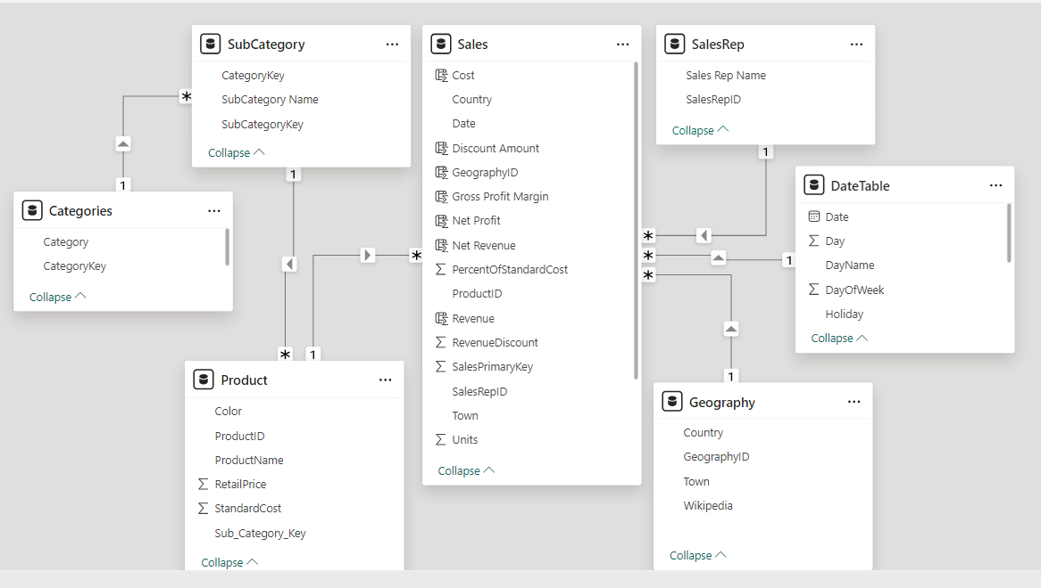
DATA MODELLING - Week 2
Connections by identifying primary key & foreign key
Created a Geography ID for geography
Added Date Table
Added Calculated columns
Added Calculated measures

Slide 22
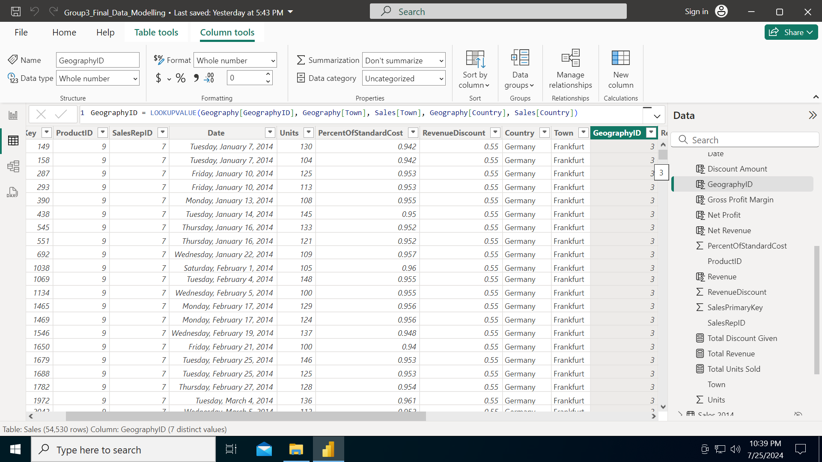
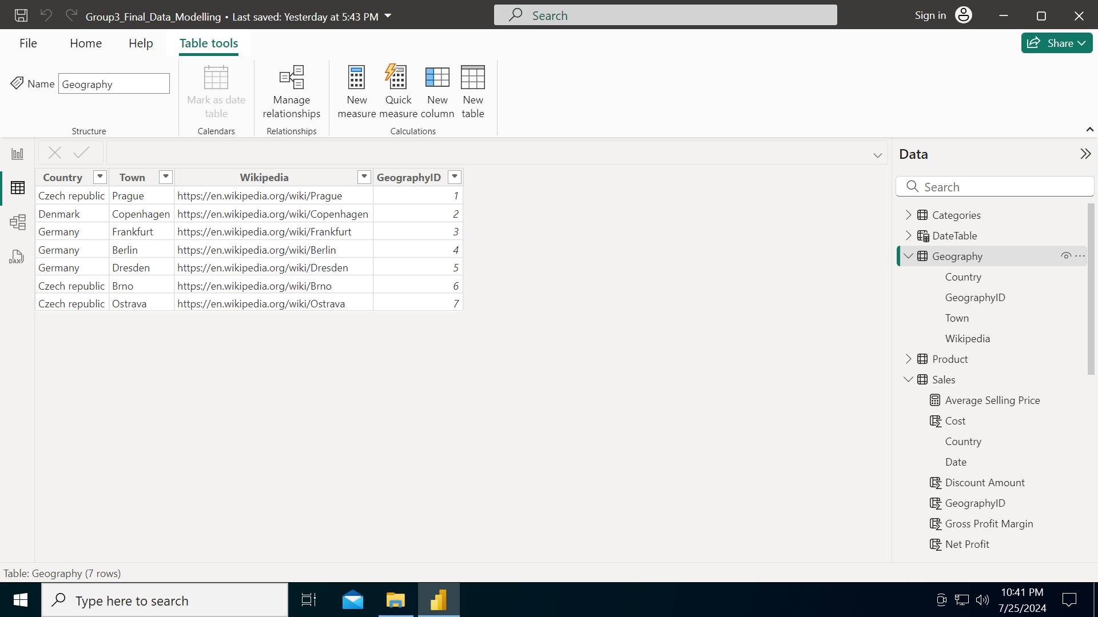
Geography ID creation
Geography ID creation
Date Table
Calculated columns
Calculated measures
Formula
Index

Slide 23
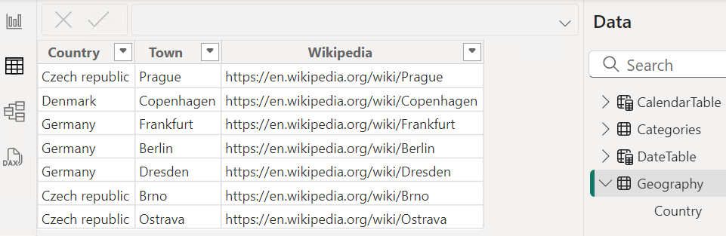
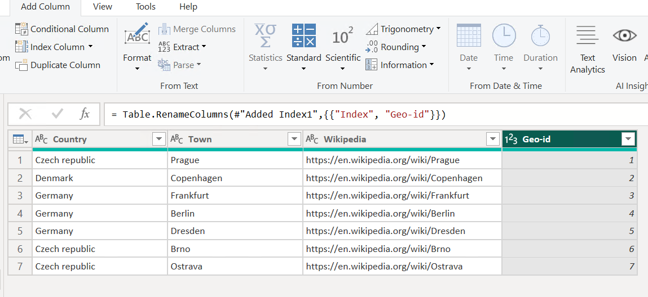
Geography id creation - Alternate approach

Slide 24
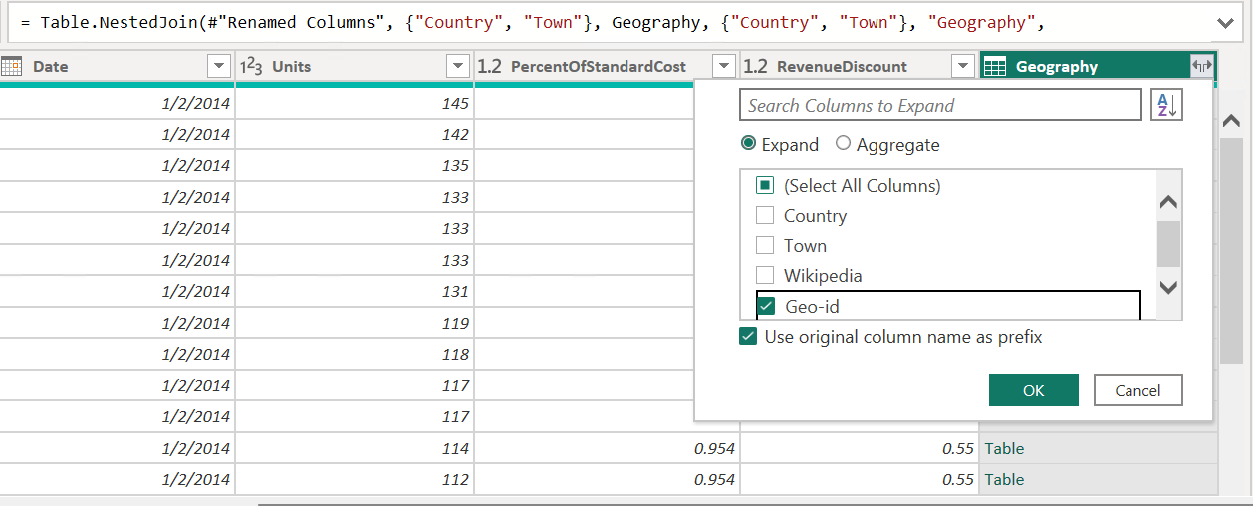
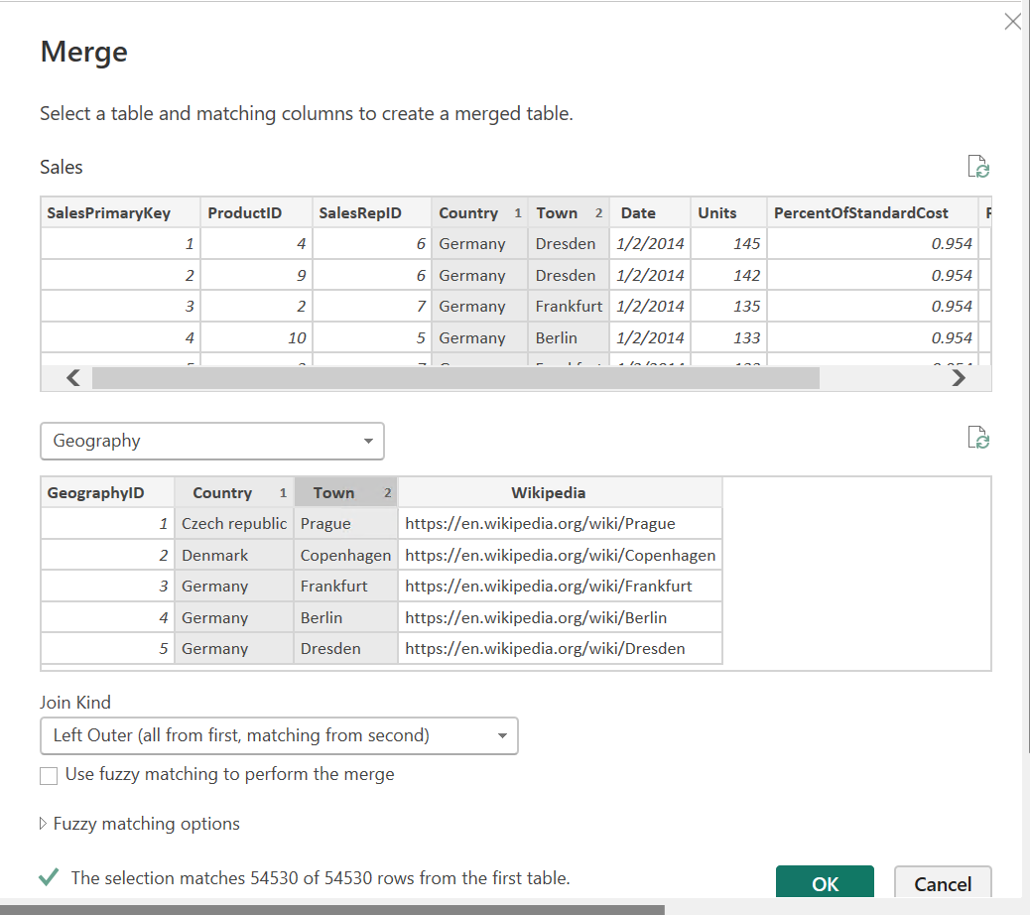
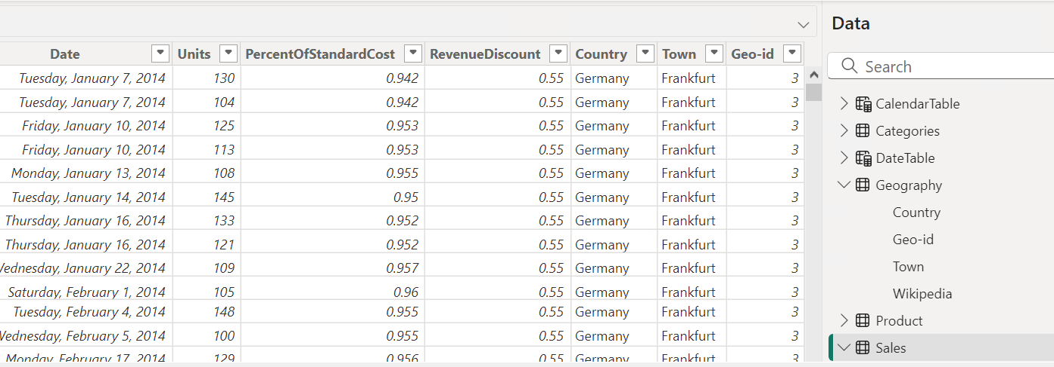
Merge query - to insert geo-id in sales table

Slide 25
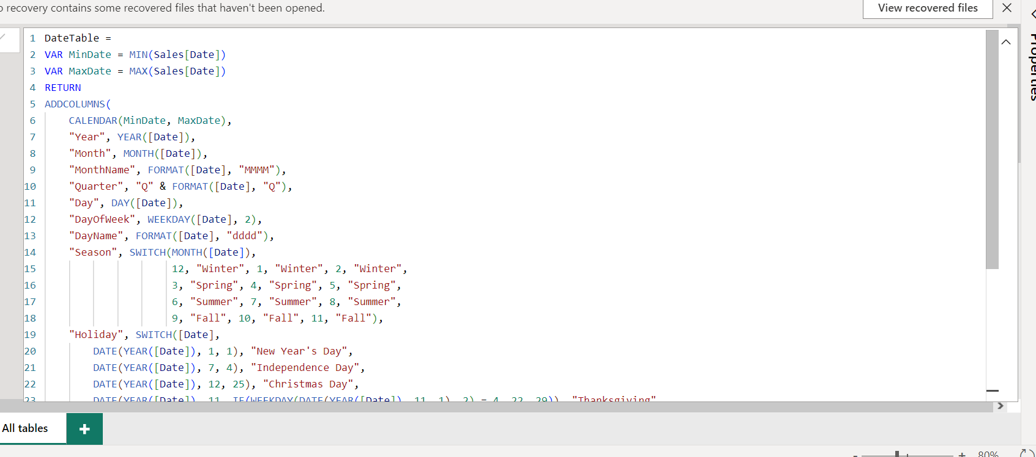
2. Date Table
Note: We decided to include local holidays for the countries to analyse if sales affected around local holiday .
Geography ID creation
Date Table
Calculated columns
Calculated measures
DAX Formula

Slide 26
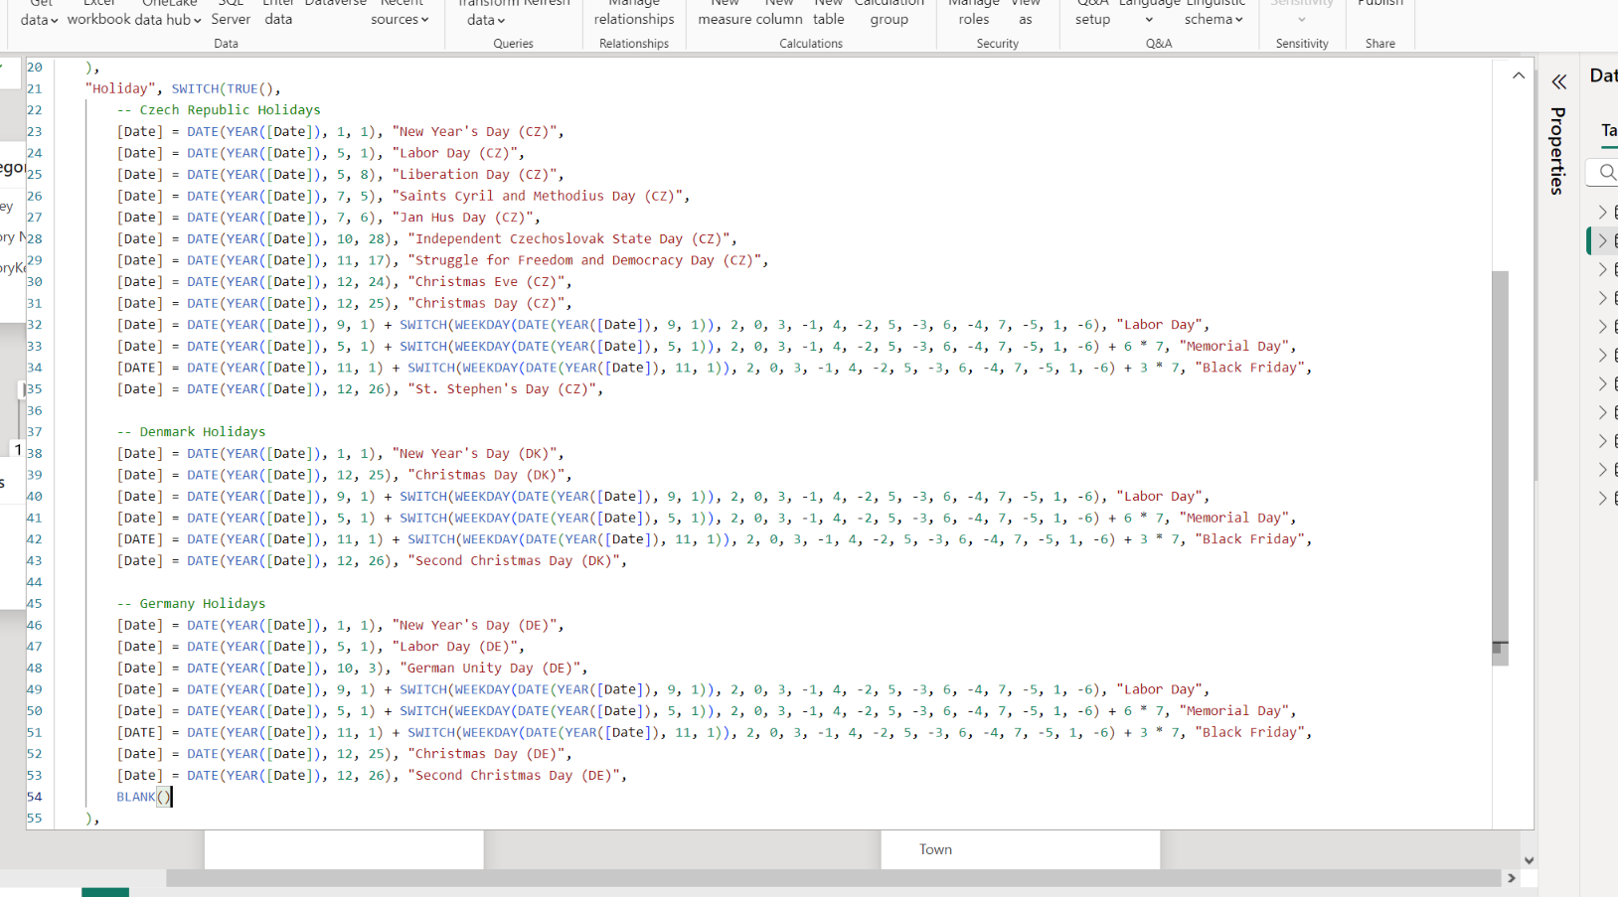
2. Date Table
Note: We decided to include local holidays for each countries to analyse if sales affected around local holiday .
Geography ID creation
Date Table
Calculated columns
Calculated measures
DAX Formula

Slide 27
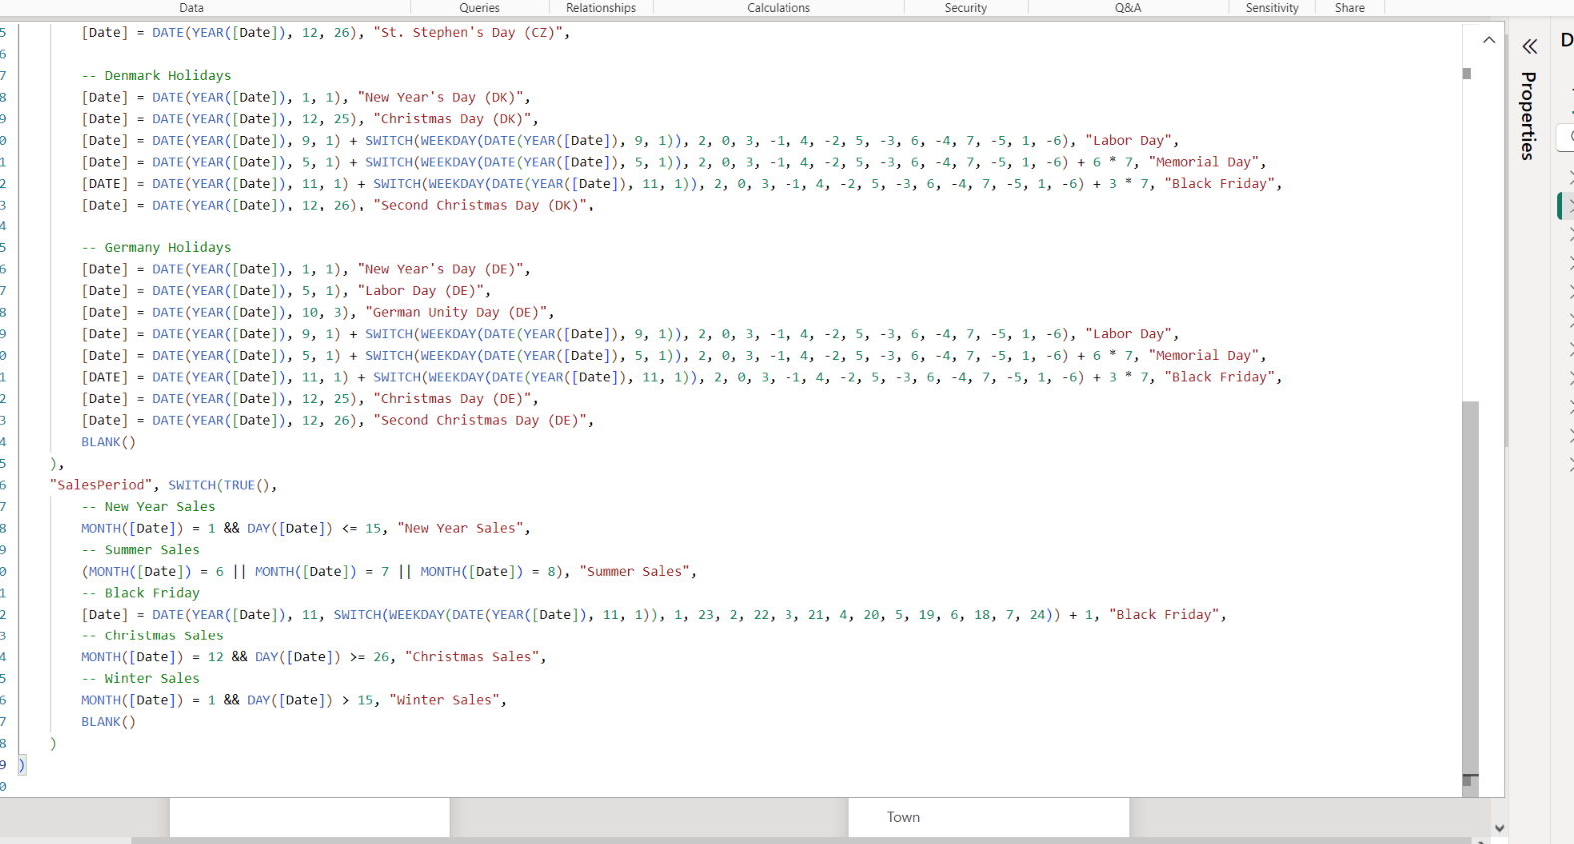
2. Date Table
Note : sales period as per holidays .
Geography ID creation
Date Table
Calculated columns
Calculated measures
DAX Formula

Slide 28
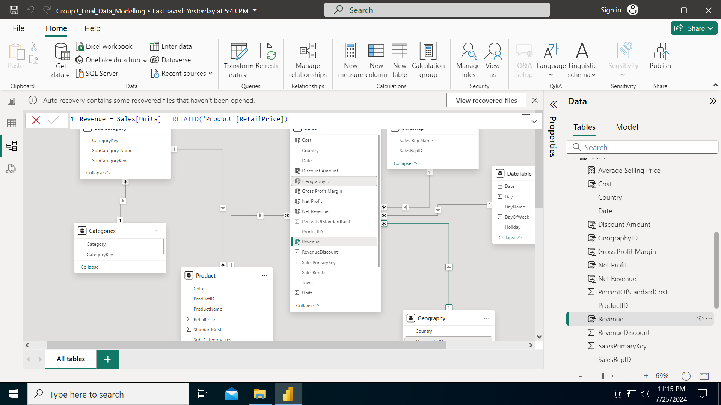
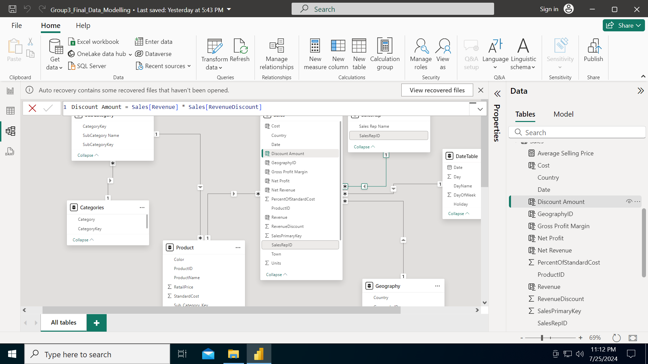


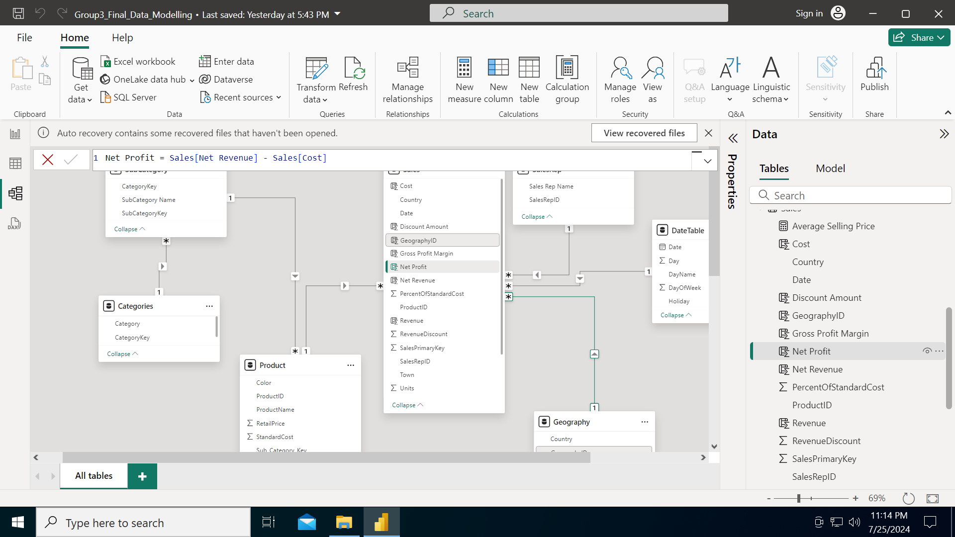

3. Calculated columns
column
DaX formula
Revenue
Geography ID creation
Date Table
Calculated columns
Calculated measures
Discount Amount
Net Revenue
Cost
Net Profit
Gross Profit Margin

Slide 29
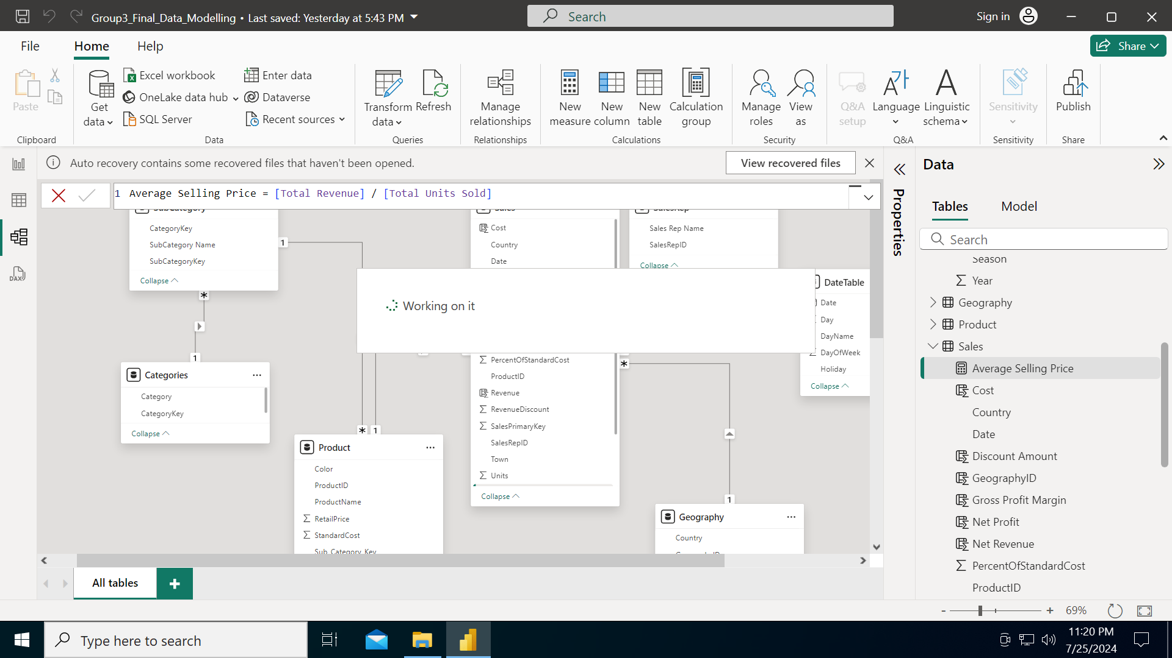
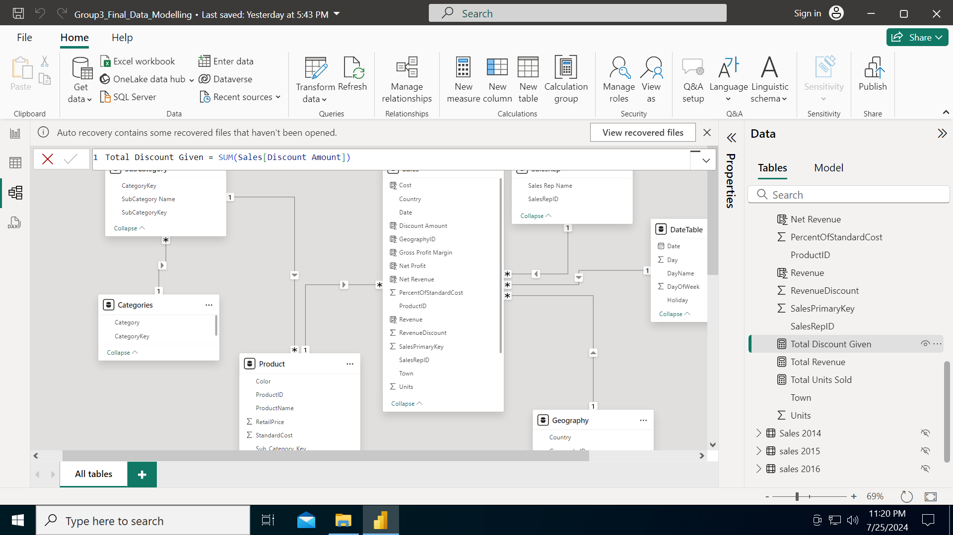


4. Calculated measures
Measure
DaX formula
Average Selling price
Geography ID creation
Date Table
Calculated columns
Calculated measures
Geography ID creation
Date Table
Calculated columns
Calculated measures
Total Discount Given
Total Revenue
Total Units sold

Slide 30
APPROACH - Data Visualization
We plan to have the following key pages as mentioned below for our Power BI report. Team members responsible for each are as indicated
Overview (Key Performance Indicators): Parina & Team
Sales Analysis: Aditya
Product Category Insights: Vidita
Geographic Market Exploration: Shikha
Sales Rep Performance: Parina

Slide 31
Phase 3 - Data Visualization (Initiated)
Geography
Data Modeling
Relationships: Relationships to be defined between tables (e.g., sales data linked to product categories, Revenue data, etc.).
2. Calculated Columns and Measures: Create calculated columns and measures to derive insights. For example:
Total Sales: Total Sales = SUM(Sales[Amount])
Total Profit: Total Profit = SUM(Sales[Profit])
Sales Growth: Sales Growth = (SUM(Sales[Amount]) - SUM(Sales[Amount])) / SUM(Sales[Amount])
3. Insights:
- Sales Performance ( Revenue and units sold )
- Seasonality trend ( season trend , market trend)
Product Category Insights
Data Modeling
Relationships: Relationships to be defined between tables (Having a many to 1 cardinality between sales and geography table..
2. Calculated Columns and Tables: Create calculated columns and measures to derive insights. For example:
Distinct List of Countries = DISTINCT(Geography[Country])
Total Countries = COUNTROWS(DISTINCT(Geography[Country)]
Towns grouped by country = SUMMARIZE(Geography,Geography[Country],”Towns”,CONCATENATAX(Geography,Geography[Town],”,”))
3. Insights:
- Top 5 performing countries with respect to revenue and units
- Countries having least amount of revenue
- Geographical Spread

Slide 32
CONCLUSION
Project work - On time (No potential hurdles)
All team members have access to VM
Technical review done for the final consolidated file till now (peer review)
Prep for PL 300 - On time (All team members referring material)

